Slide 1

NATIONAL CENTER FOR CONSTRUCTION EDUCATION AND RESEARCH
CONSTRUCTION SITE SAFETY
ORIENTATION PROGRAM

Slide 2
OVERVIEW
The CSSO is a basic safety program for:
New employees
Students in craft training programs
Experienced employees with new job assignments
It is truly an orientation program. Additional training will be required for certain tasks like confined space entry.

Slide 3
LEARNING OBJECTIVES
    Identify the role of OSHA in job-site safety.
    Describe the impact of an accident on the company, the individual, and the family.
    Identify various fall hazards, means of fall protection, where/when fall protection is required, and company/site fall protection requirements.
    Understand the proper use of ladders and scaffolding.
    Recognize various electrical hazards on a job site.
    Understand the proper use of hand and power tools.

Slide 4
LEARNING OBJECTIVES, CONT.
    Identify the hazards of and the safety procedures for working in or near an excavation.
    Describe the emergency procedures for trenching accidents.
    Identify the hazards of working on or around heavy equipment.
    Explain the different signs and barricades on a job site.
    Identify the hazards of material handling.
    Describe proper rigging safety.
    Describe the proper use of personal protective equipment.

Slide 5
OCCUPATIONAL SAFETY AND HEALTH ACT 1970
OSHA
Since 1970, the Occupational Safety and Health Administration (OSHA) has been working to save lives and prevent injuries and illnesses in American workplaces. Over the past 30 years, the workplace death rate has been cut in half. Still, about 17 Americans die every day on the job.

Slide 6
ACCIDENT
An unplanned and sometimes injurious or damaging event which interrupts the normal progress of an activity.
It is invariably preceded by an unsafe act or unsafe condition.

Slide 7
INCIDENT
An undesired even that, under slightly different circumstances, could have resulted in personal harm or property damage.
Any undesirable loss of resources.

Slide 8
“I’ve done it that way a hundred times, and nothing ever happened.”

Slide 9
ACCIDENT STUDY RATIO
SERIOUS OR DISABLING
1
MINOR INJURIES
10
PROPERTY DAMAGE ACCIDENT
30
INCIDENTS WITH NO
VISIBLE INJURY OR DAMAGE
(NEAR MISS)
EVENT
600
UNSAFE ACT OR
UNSAFE CONDITION

Slide 10

DIRECT VS. INDIRECT
COST OF AN
ACCIDENT
Medical bills
Compensation
Benefits
EMR increase
Re-training
Property damage
Equipment damage
Production delays
Supervisory time

Slide 11
EXPERIENCE MODIFICATION RATE (EMR)
The rate charged to the company for worker’s compensation.
Much like the rates on auto insurance, the greater number of accidents, the higher the cost of insurance.

Slide 12
LIST THE EFFECTS OF AN ACCIDENT ON YOU
Personally
Family
Income
Possible long-term effects

Slide 13
10 BASIC RULES OF SAFETY
Use your tools, equipment, and PPE the way they were designed.
Wear your hard hat and safety equipment at all times where required.
Inspect your equipment daily.
Only perform tasks for which you have been trained.
Understand your company safety rules and policies.

Slide 14
10 BASIC RULES OF SAFETY
(CONTINUED)
Take responsibility for yourself and your co-workers.
Correct or report all unsafe conditions to your supervisor immediately.
Accept the "Zero Accident" philosophy.
Get involved with your company safety program.
When in doubt, STOP AND ASK!

Slide 15
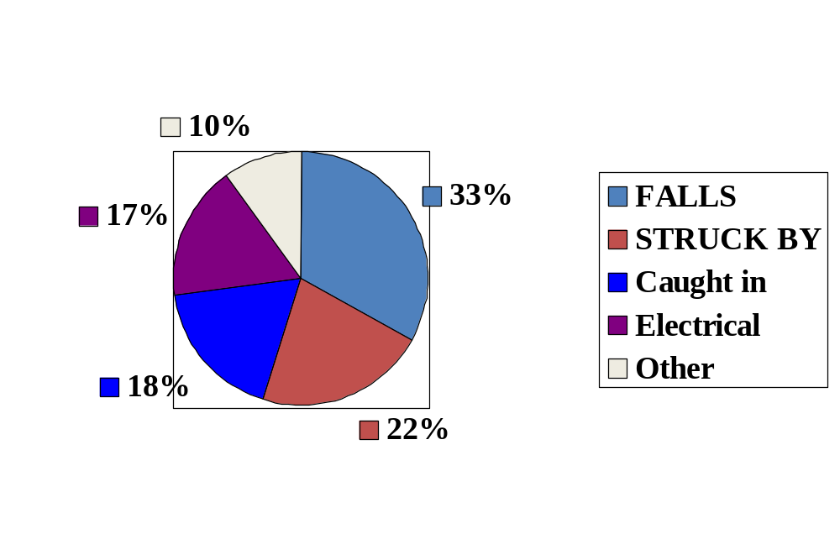
THE LEADING CAUSES OF DEATH IN CONSTRUCTION

Slide 16
TYPES OF FALL PROTECTION
Personal fall arrest system
Guardrails
Safety nets
Other options may exist

Slide 17
PERSONAL FALL
ARREST SYSTEM
Harness
Lanyard
Shock-absorbing retractable device
Tie-off point

Slide 18
WHEN DO I NEED TO WEAR MY PERSONAL FALL PROTECTION SYSTEM?
0 feet • 6 feet
10 feet • 30 feet

Slide 19
LADDER SAFETY
Only use on stable surfaces
Must extended 3 ft above the landing surface or tied off and secured
Must have a grab-rail on top
Must be inspected prior to use and tagged if defective
Must not be painted or otherwise coated to prevent inspection

Slide 20
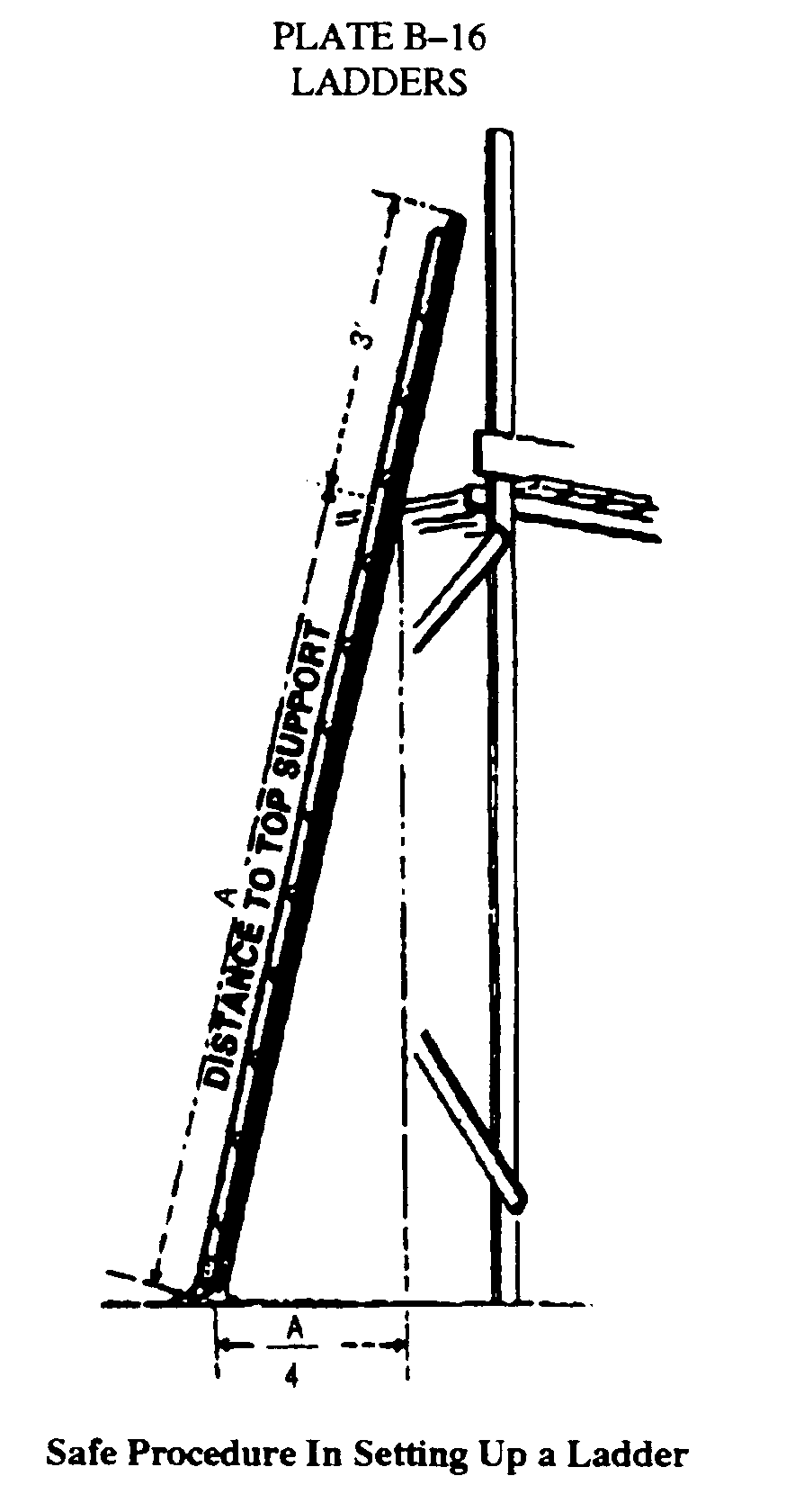
LADDERS
4 to 1 ratio
4 feet up and
1 foot out at bottom

Slide 21
SCAFFOLDS
Require a competent person for erection, dismantlement, or relocation
Walkways or ladders must be provided so that employees can safely reach or leave any scaffold or wall. Crossbraces shall not be used as a means of access.
Each scaffold and scaffold component shall be capable of supporting, without failure, its own weight and at least 4 times the maximum intended load applied or transmitted to it.

Slide 22
MOBILE SCAFFOLDS
Workers should not be allowed to ride on mobile scaffolds except under the following conditions:
• The surface on which the scaffold is being moved is within three degrees of level and free of pits, holes, and obstructions
• The height-to-base width ratio of the scaffold during movement is two to one or less, unless the scaffold is designed and constructed to meet or exceed nationally recognized stability test requirements.

Slide 23
MOBILE SCAFFOLDS (cont.)
Workers should not be allowed to ride on mobile scaffolds except under the following conditions (continued):
• Outrigger frames, when used, are installed on both sides of the scaffolds. When power systems are used, the propelling force is applied directly to the wheels, and does not produce a speed in excess of 1 foot per second (.3 mps); and
• Workers are not allowed on any part of the scaffold which extends outward beyond the wheels, casters, or other supports.

Slide 24
ELECTRICAL HAZARDS
Shock from:
Exposed wiring
Wet condition
Arcing
Or injuries from:
Explosions
Fires
Burns

Slide 25
PREVENTING ELECTRICAL ACCIDENTS
Inspect your tools and equipment
Assured grounding program
Ground-fault circuit interrupters (GFCI)

Slide 26
ASSURED GROUNDING PROGRAM
Coded tags attached to all temporary cord sets and equipment connected by cord and plug. Testing the continuity and polarity of the system being tested.

Slide 27
ASSURED GROUNDING PROGRAM (CONT.)
Our assured
grounding program:
?

Slide 28
GROUND-FAULT CIRCUIT INTERRUPTER (GFCI)
1/40 of a second
that can save
your life

Slide 29

HAND TOOL
SAFETY
Inspect and maintain
Know how to correctly use the tool
Use the correct tool for the job
Do not alter the guards!

Slide 30
POWER TOOL SAFETY
Brace yourself in case of jamming
Always use both hands
Constant-on or trigger-locking switches shouldn’t be used
ALWAYS disconnect the power source before replacing moving parts.
ALWAYS test and reset a GFCI before you use it.

Slide 31
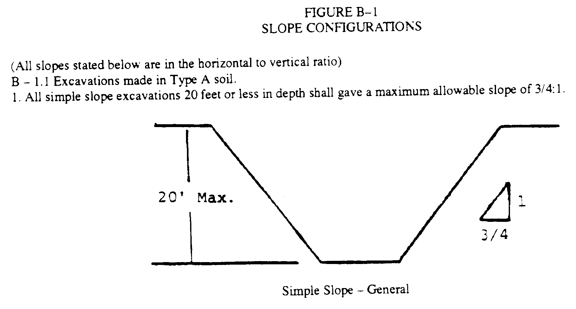
SAMPLE OF SIMPLE SLOPING

Slide 32
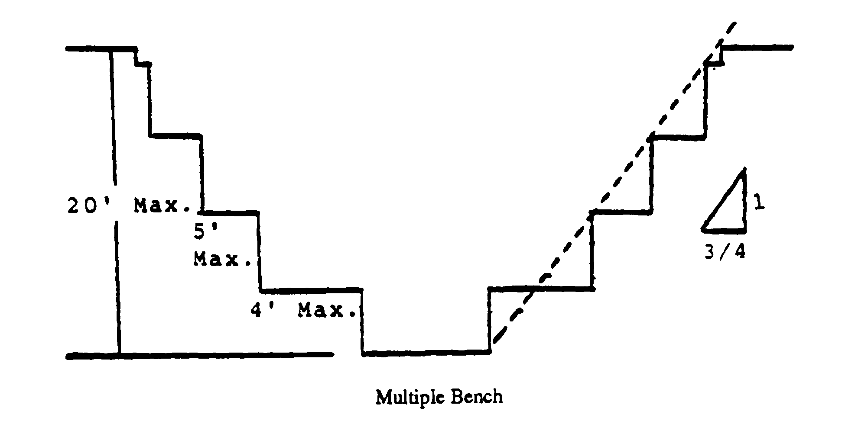
BASIC BENCHING

Slide 33
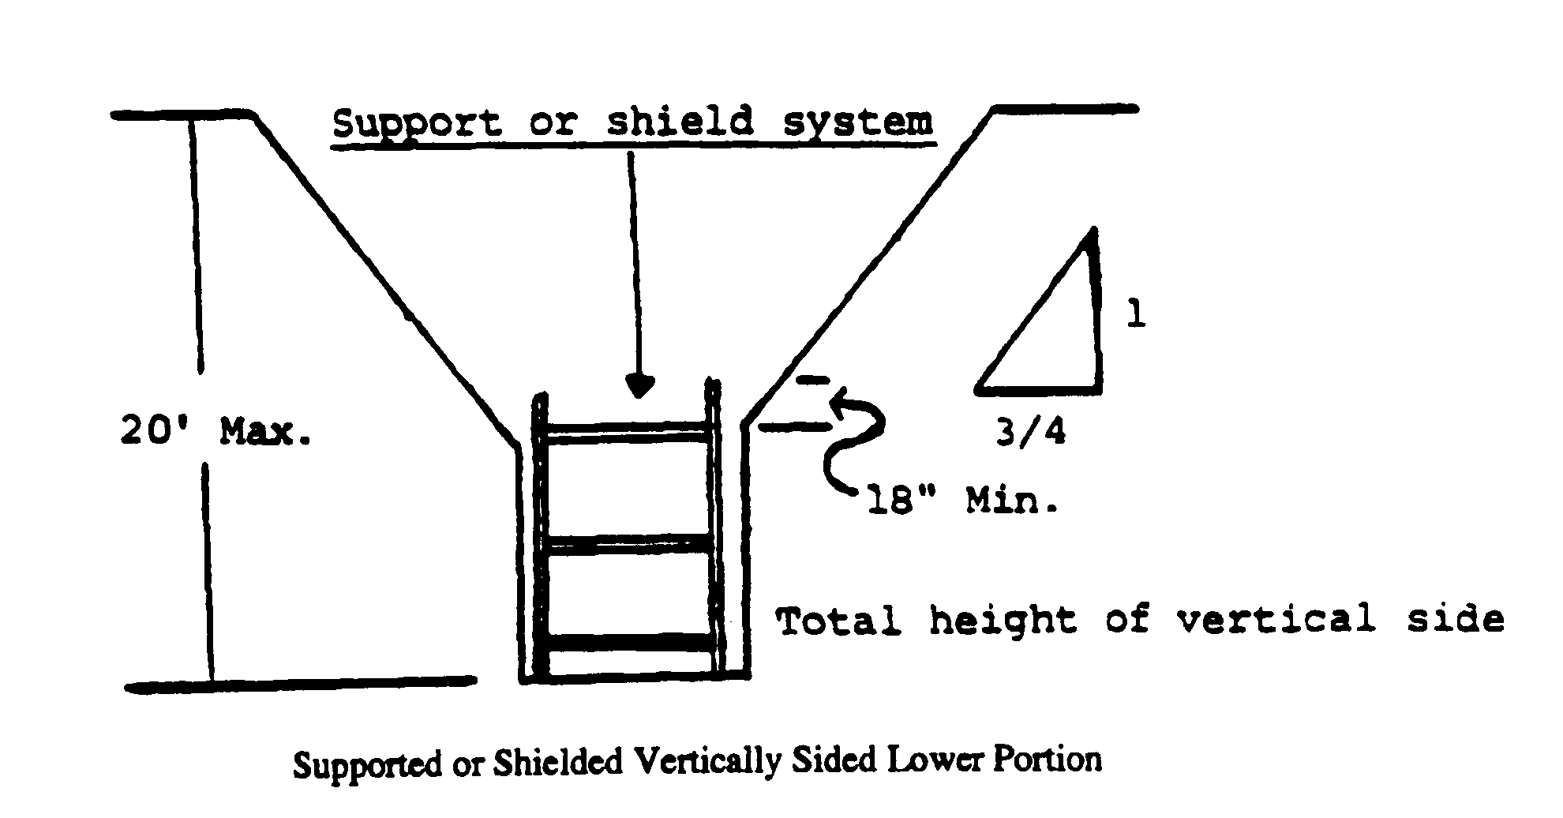
BASIC SHIELD SYSTEM

Slide 34
PERSONAL PROTECTIVE EQUIPMENT REQUIRED HERE!
Head
Eye
Face
Hearing protection
Respirators
Others as needed

Slide 35
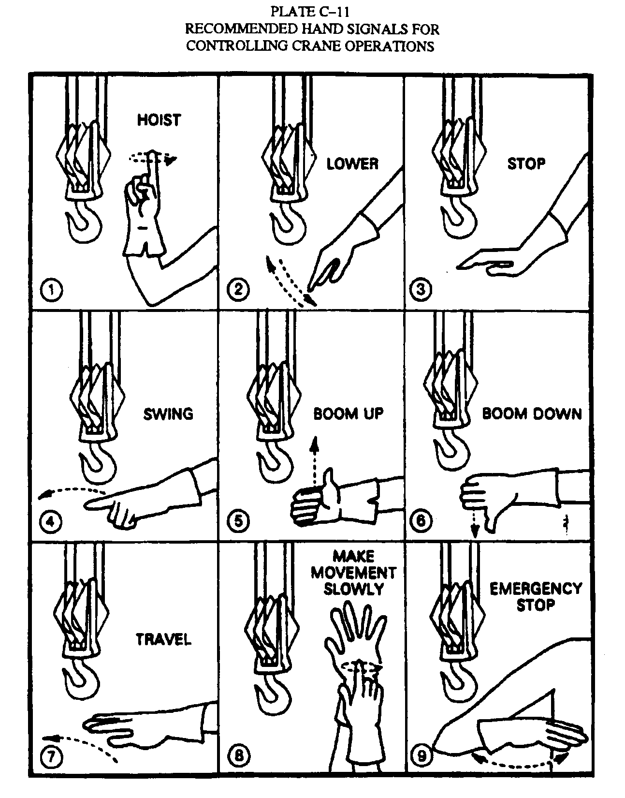
BASIC
RIGGING

Slide 36
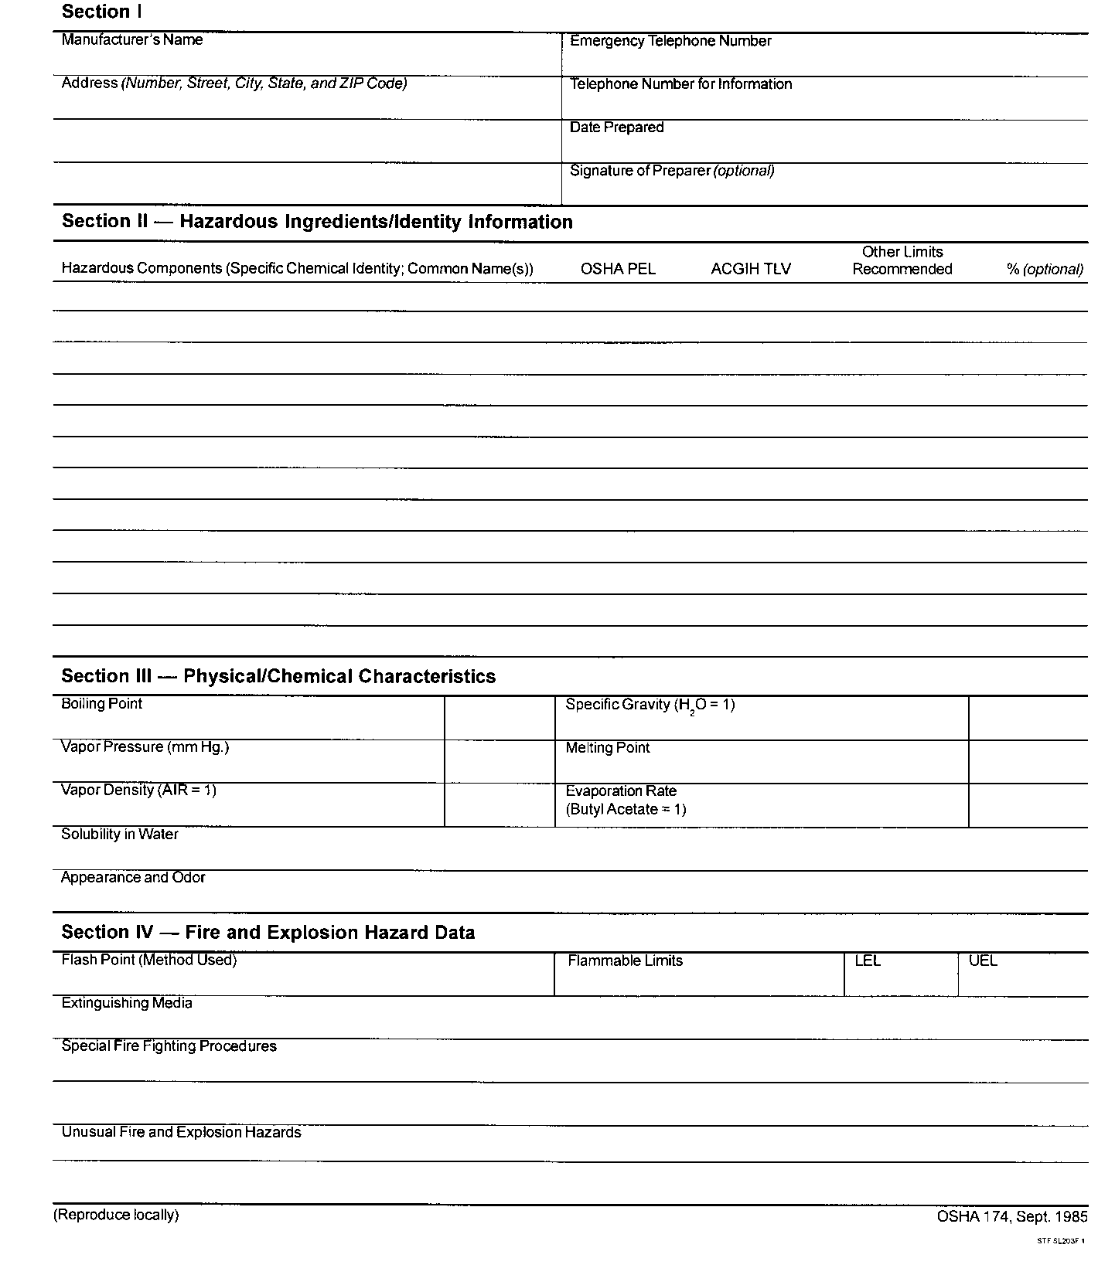

Slide 37
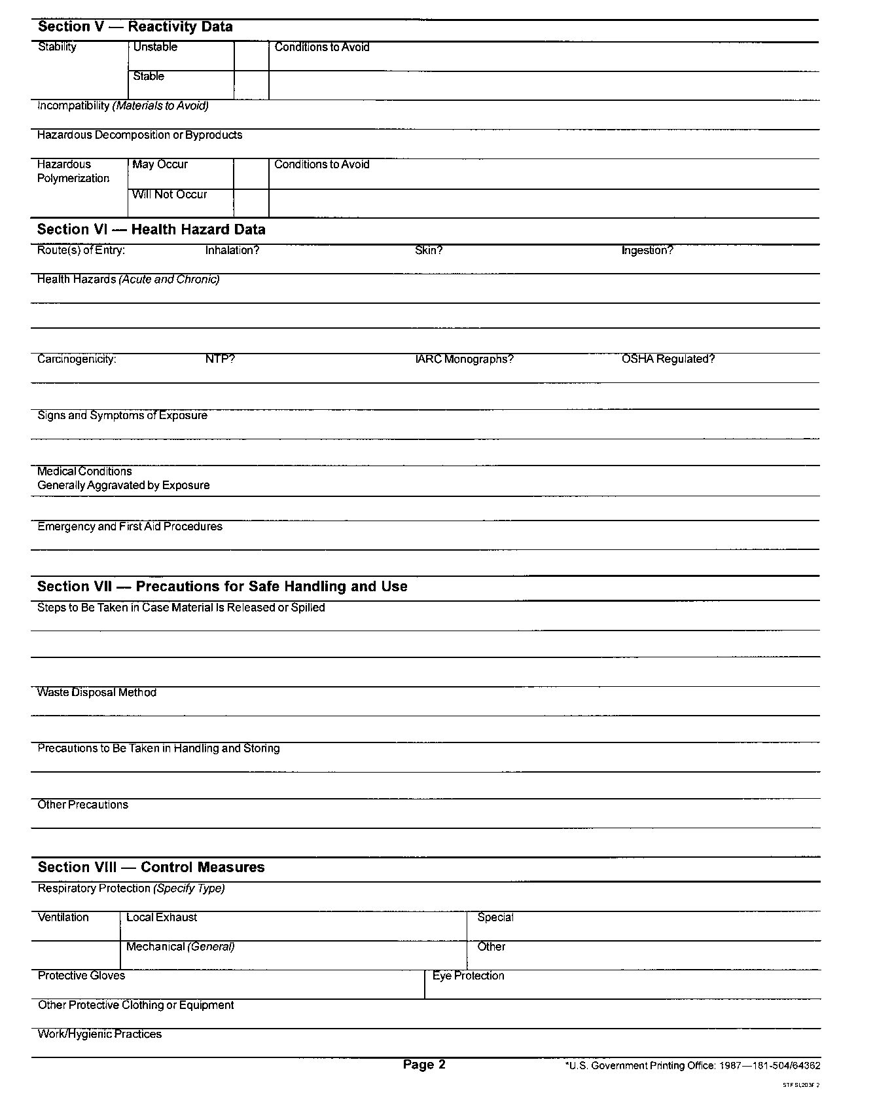

Slide 38
SAFE

Slide 39

FIRE EXTINGUISHER CLASSES
A - Ash, any materials that leave ash (wood, paper, cloth, etc.)
B - Barrel, flammable liquids
C - Current, electrical fires
D - Metals
ABC - Multiple

Slide 40
FIRE EXTINGUISHER OPERATION
The P.A.S.S. System
Pull the pin
Aim at the base of the fire
Squeeze the trigger
Sweep back and forth

